Slide 1
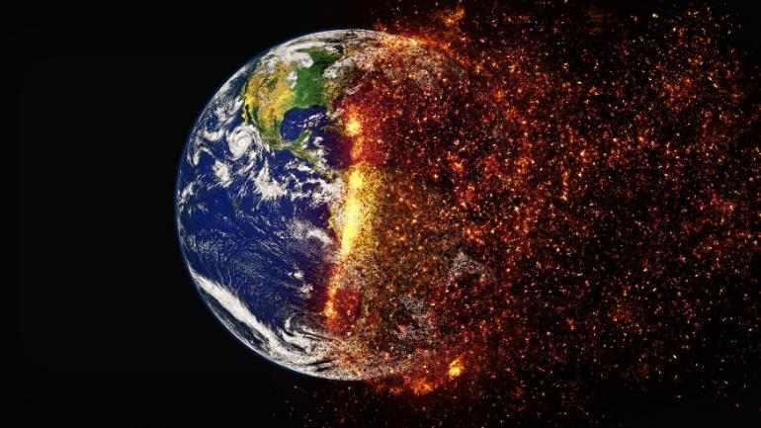
HUMANS ARE THE MOST DANGEROUS SPECIES ON THE PLANET EARTH

Slide 2
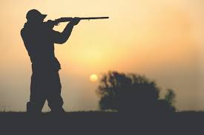
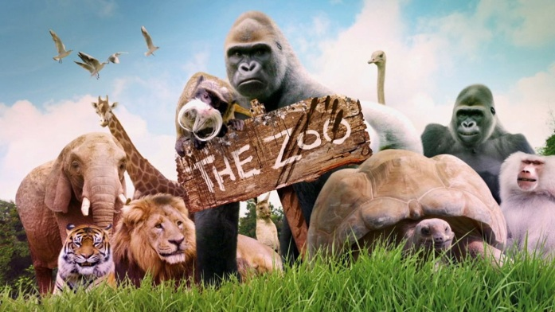
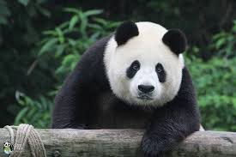
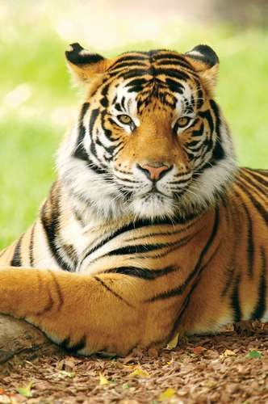
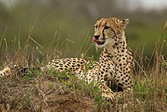
For Animals
Hunting
Zoo
Animals in Danger
By: KABEER AHMED

Slide 3
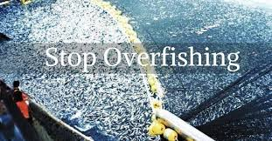
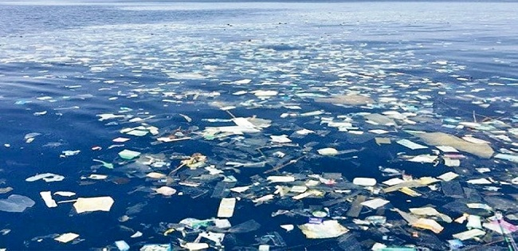
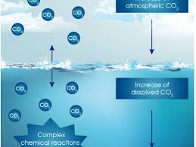
For Aquatic Life
Overfishing
Marine pollution
Ocean acidification
By: KABEER AHMED

Slide 4
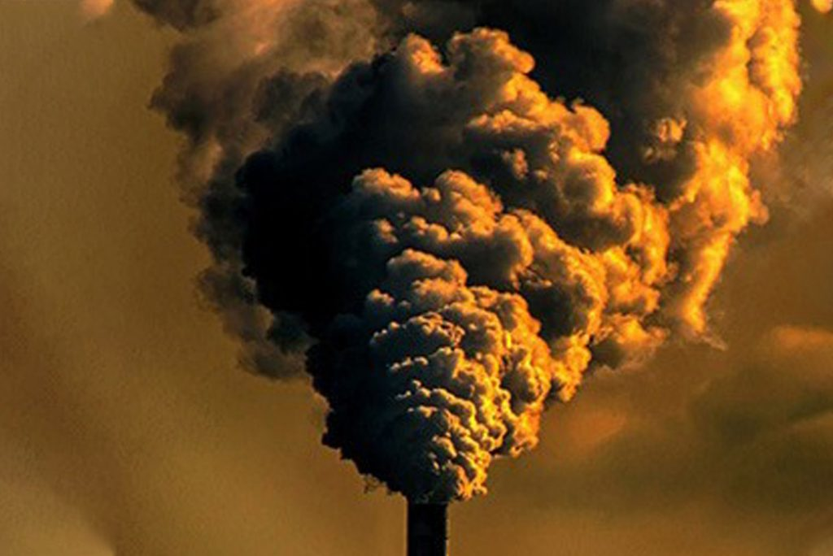
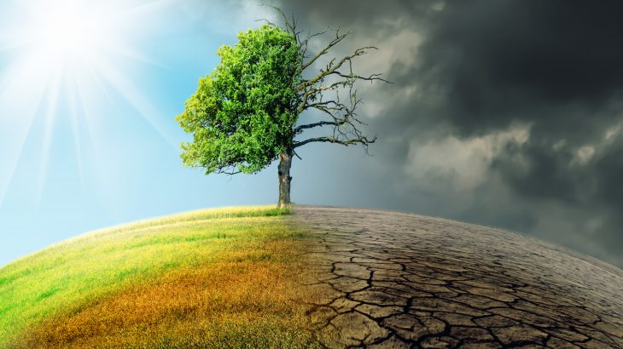
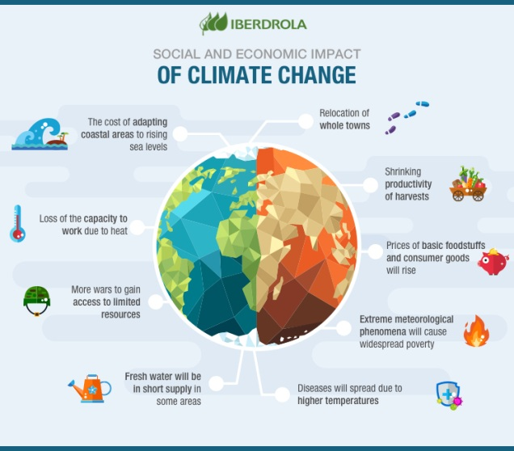
For Earth
Air Pollution
Deforestation
Climate change
By: KABEER AHMED

Slide 5
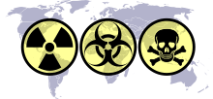
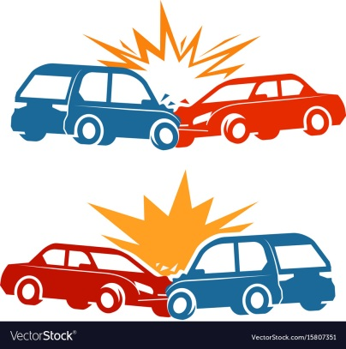
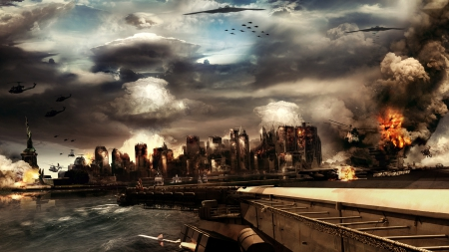
For Humans
Weapons
Traffic Accidents
Wars
By: KABEER AHMED

Slide 6
Thank you
By: KABEER AHMED

